Slide 1

Automated gating of flow cytometry data via Markov Random Fields
Kevin Brosnan, University of Limerick

Slide 2
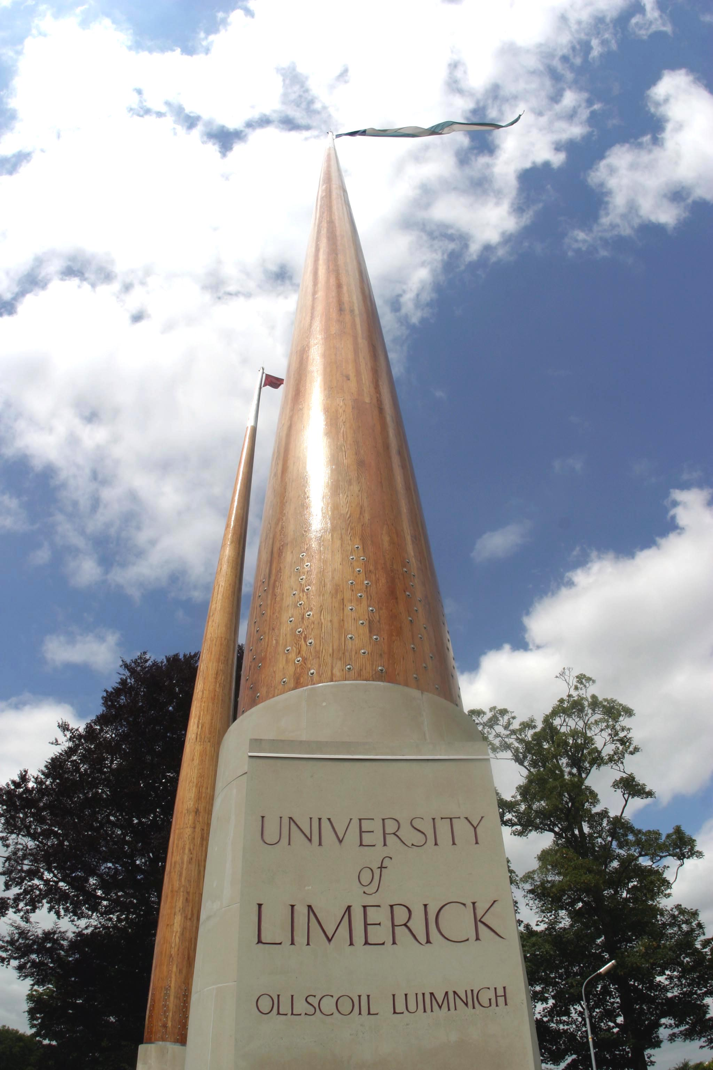

Presentation
outline
Flow Cytometry
Existing methods
Markov Random Fields
Cluster Identification
Results
Further Work

Slide 3
Flow cytometry…

Slide 4
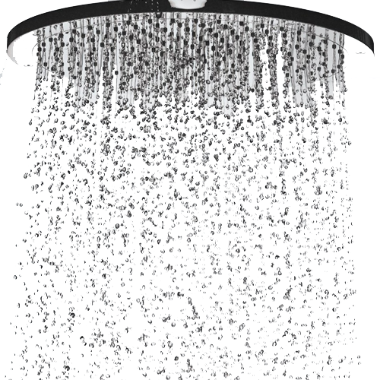






What is flow cytometry?
metry
Cyto
Flow

Slide 5
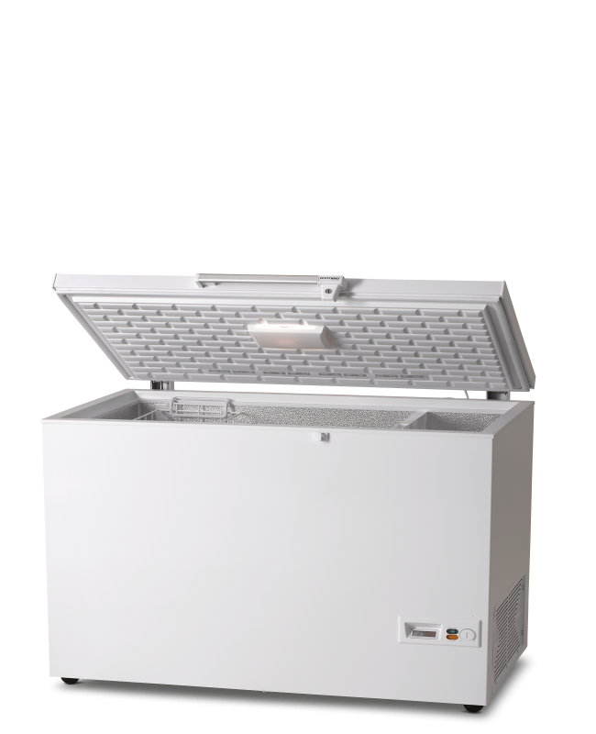
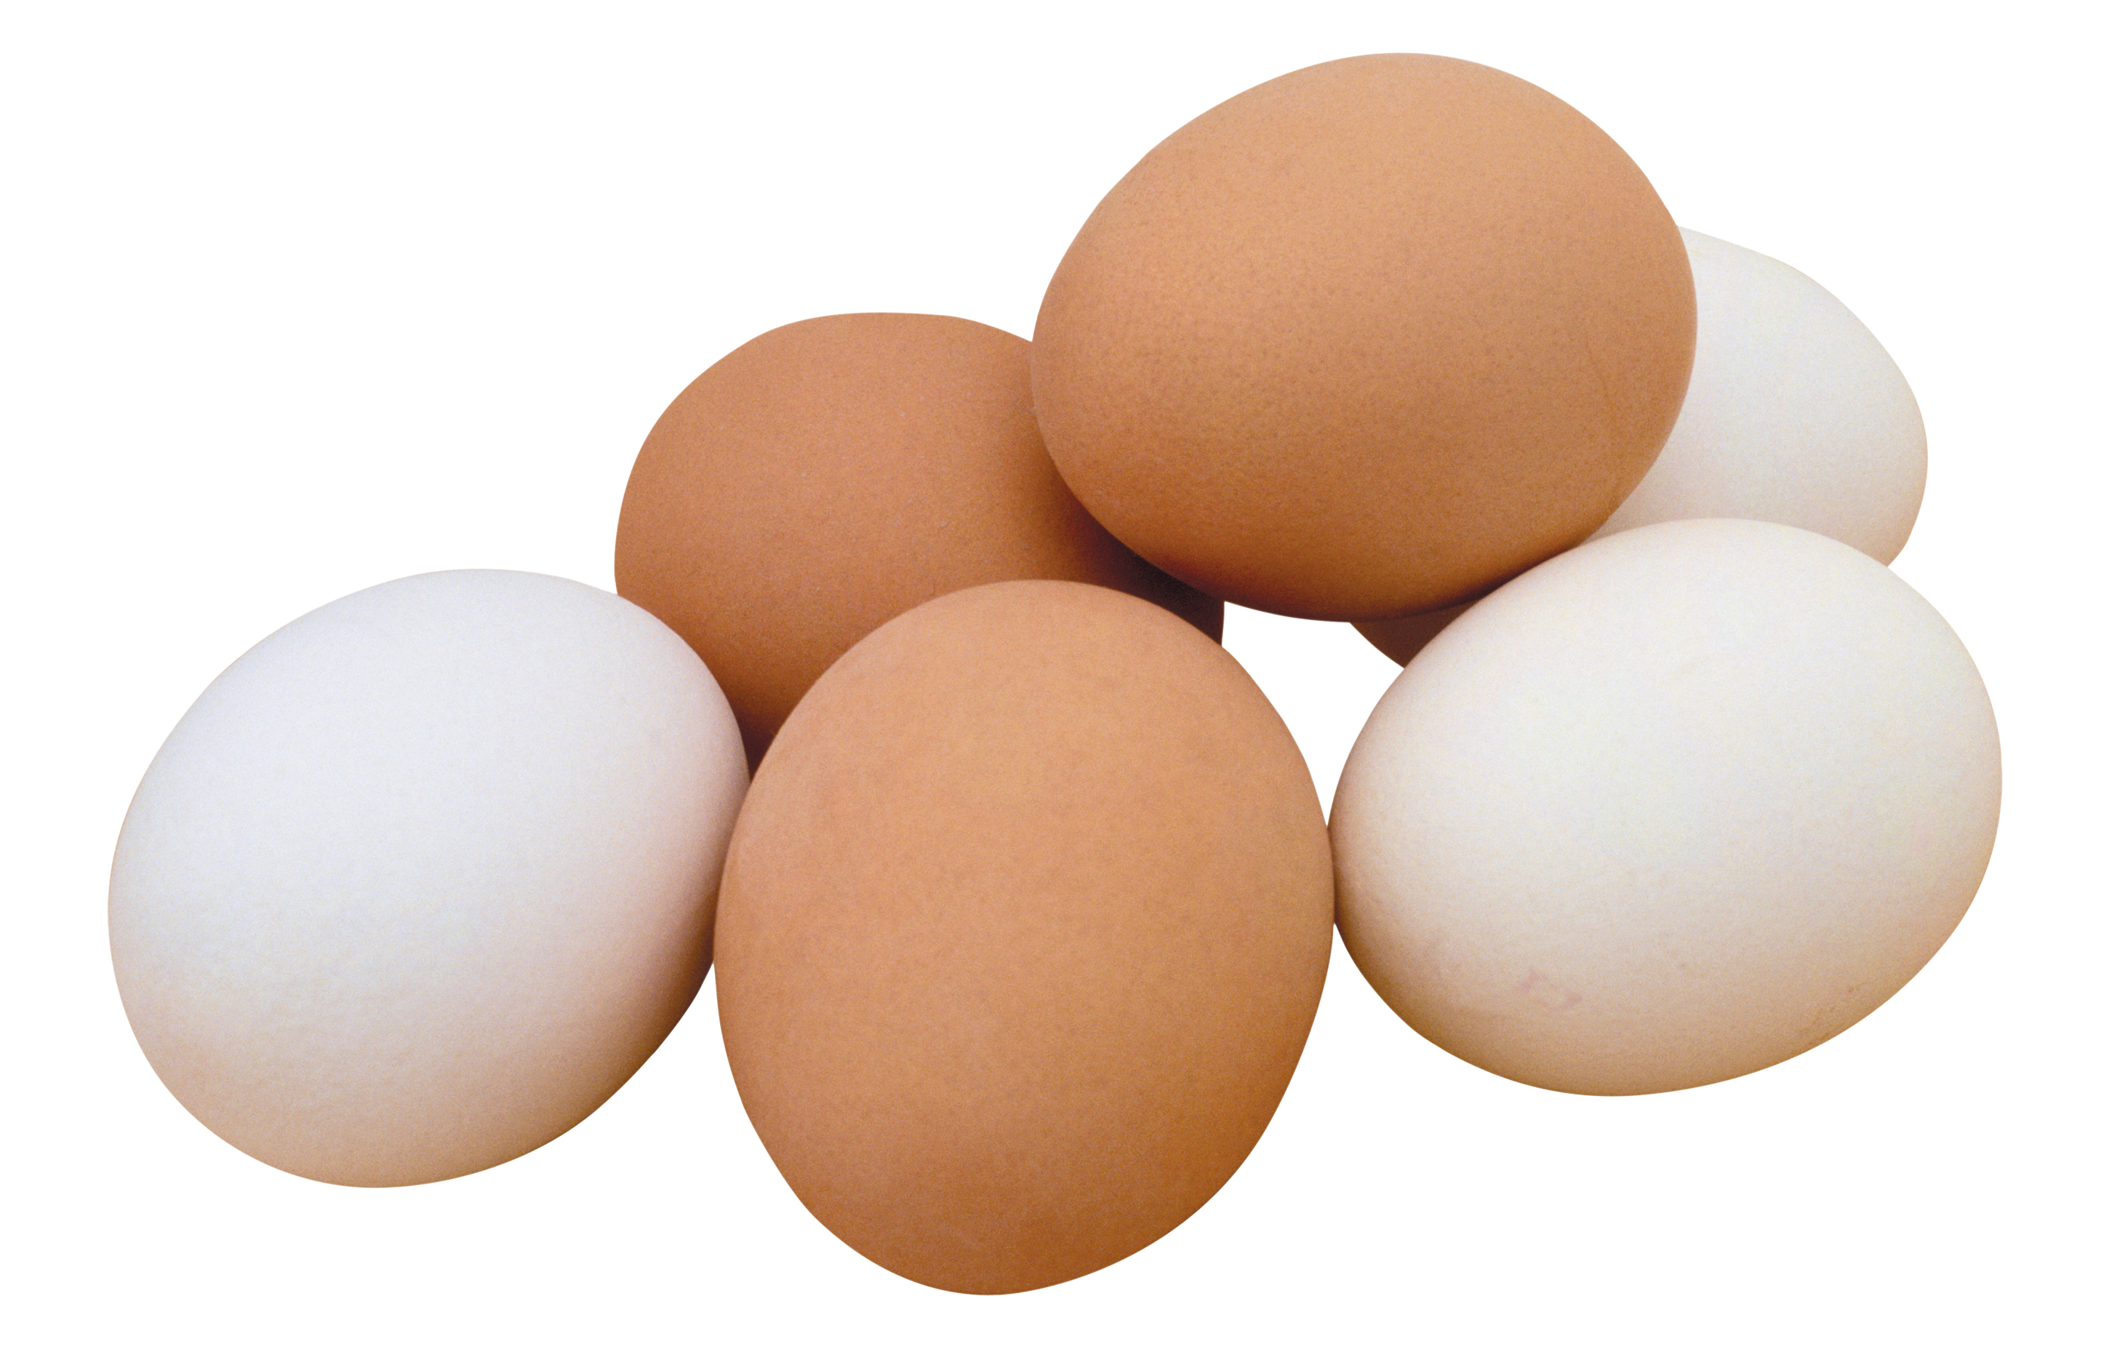
Data Storage…

Slide 6
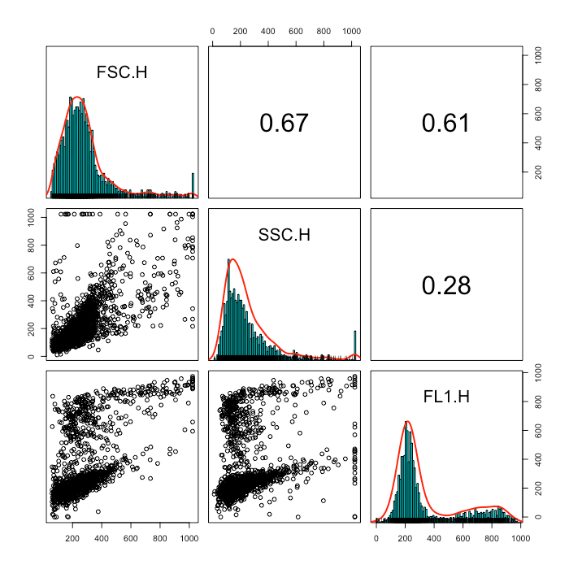
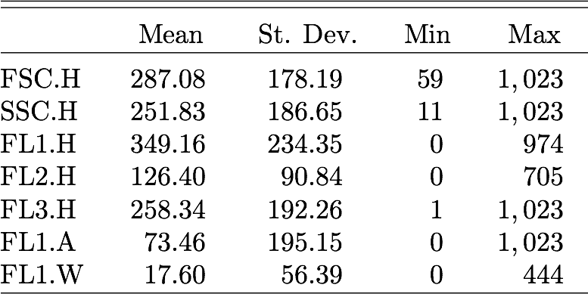
Flow Cytometry Data…

Slide 7
Existing methods…

Slide 8
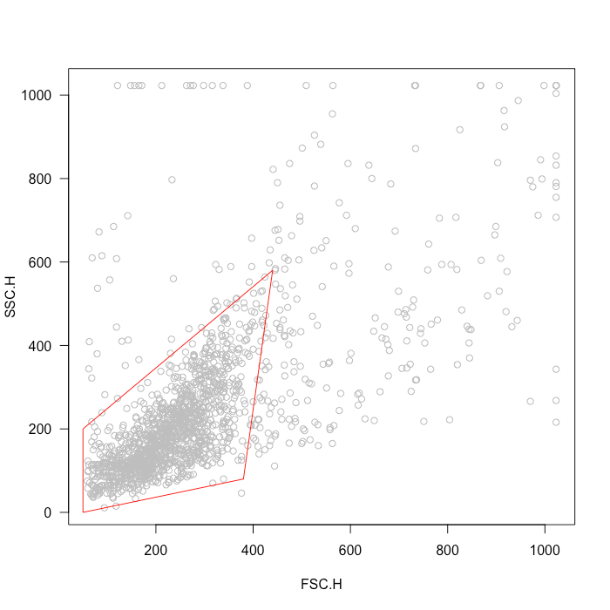
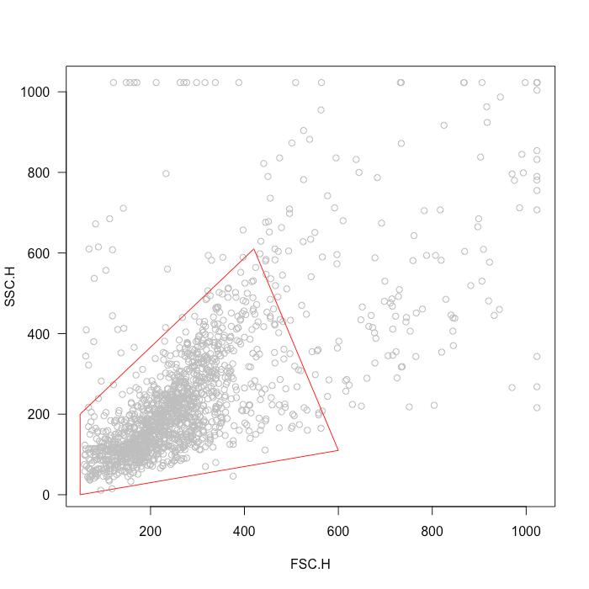
Industry Standard…
Expert 1
Expert 2

Slide 9
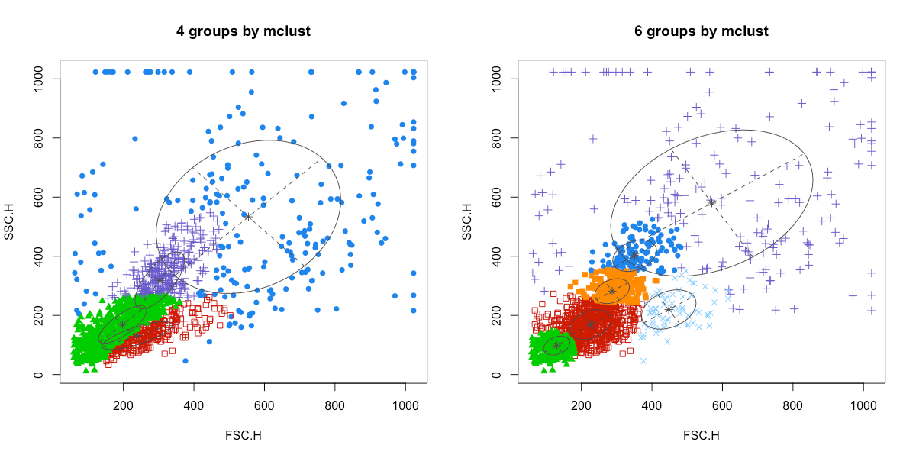
Model Based Clustering…
Notes:
Model based clustering t-distributions

Slide 10
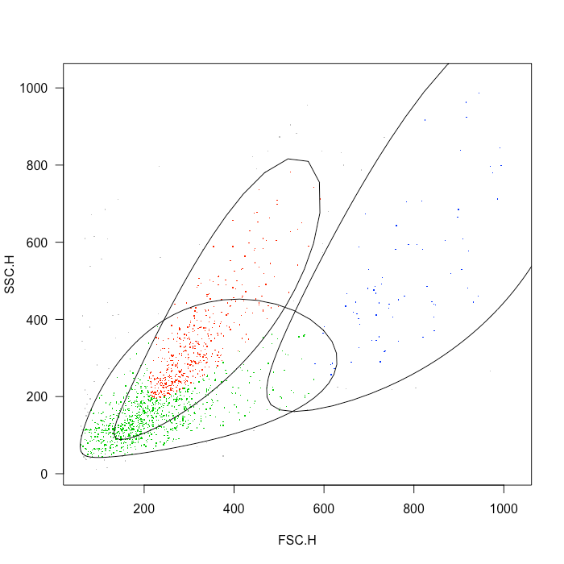
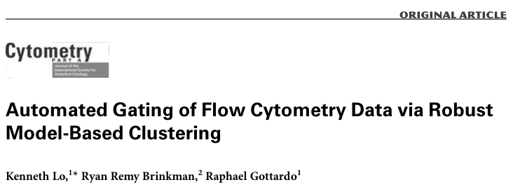
t-distribution Mixtures…
Notes:
Model based clustering t-distributions

Slide 11
Markov Random Fields…

Slide 12
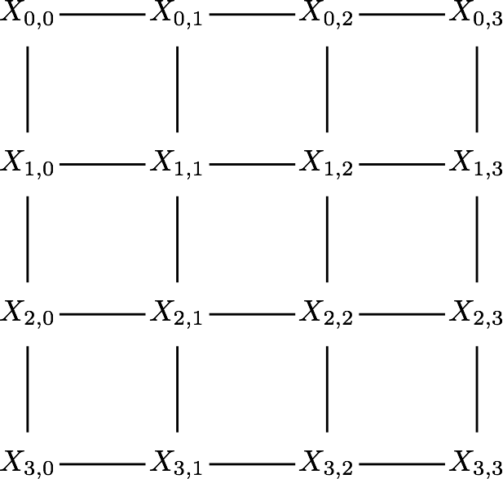

Slide 13
identifying clusters…

Slide 14
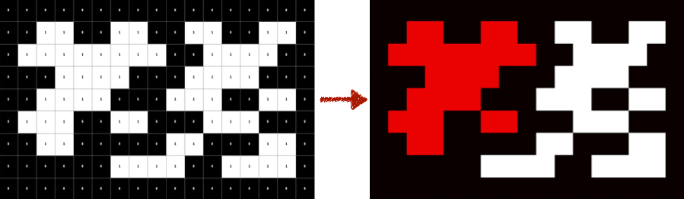
Connected Components Labelling…

Slide 15
Results…

Slide 16
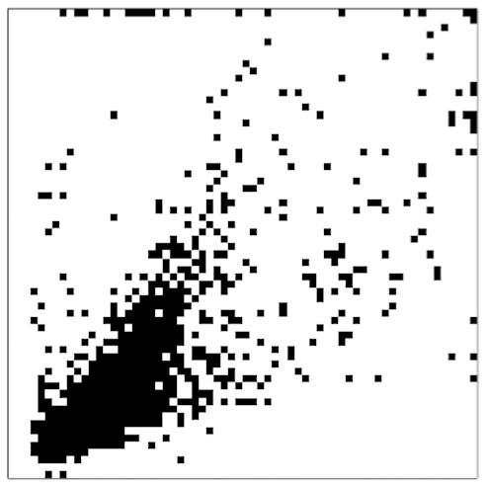
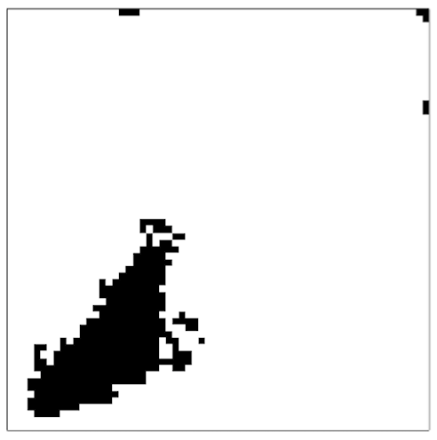
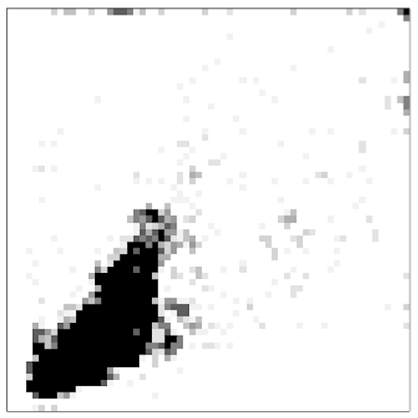
Probability Map
Original
Segmentation
Granularity
Area
Area

Slide 17
Further Work…

Slide 18





Slide 19
Thanks for listening! any questions?

